Slide 1
Business Model Title
※ This Business Model Format is designated as example for Society of Open Innovation: Technology, Market, and Complexity(SOI) & Oklahoma State University 2020 Conference, but just refer to this guideline and please fill the contents below when writing your Business Model Presentation.
- The Business Model Presentation for SOI & Oklahoma State University 2020 Conference should be about PPT 15 pages.
First Author Name
Position (Ex. Prof. Researcher, Ph.D., Master, CEO, and etc.), Affiliation (Ex. University, Institute, Company), Nationality
Email: abc@defg.hig
Second Author Name
Position (Ex. Prof. Researcher, Ph.D., Master, CEO, and etc.), Affiliation (Ex. University, Institute, Company), Nationality
Email: abc@defg.hig

Slide 2

Book Reference - Business Model Design Compass
*Please refer to the “Business Model Design Compass” book.
*Please refer to Page 158, 167, 183, 203, 221 in this book.

Slide 3
Introduction of firm(firm name)-Ⅰ
Firm(Name) was established on….

Slide 4
Introduction of firm(firm name)-Ⅱ
Now the firm(Name) is…

Slide 5
Innovative case of the firm(firm name)-Ⅰ
Innovative case one of the firm is…

Slide 6
Innovative case of the firm(firm name)-Ⅱ
Innovative case two of the firm is…

Slide 7
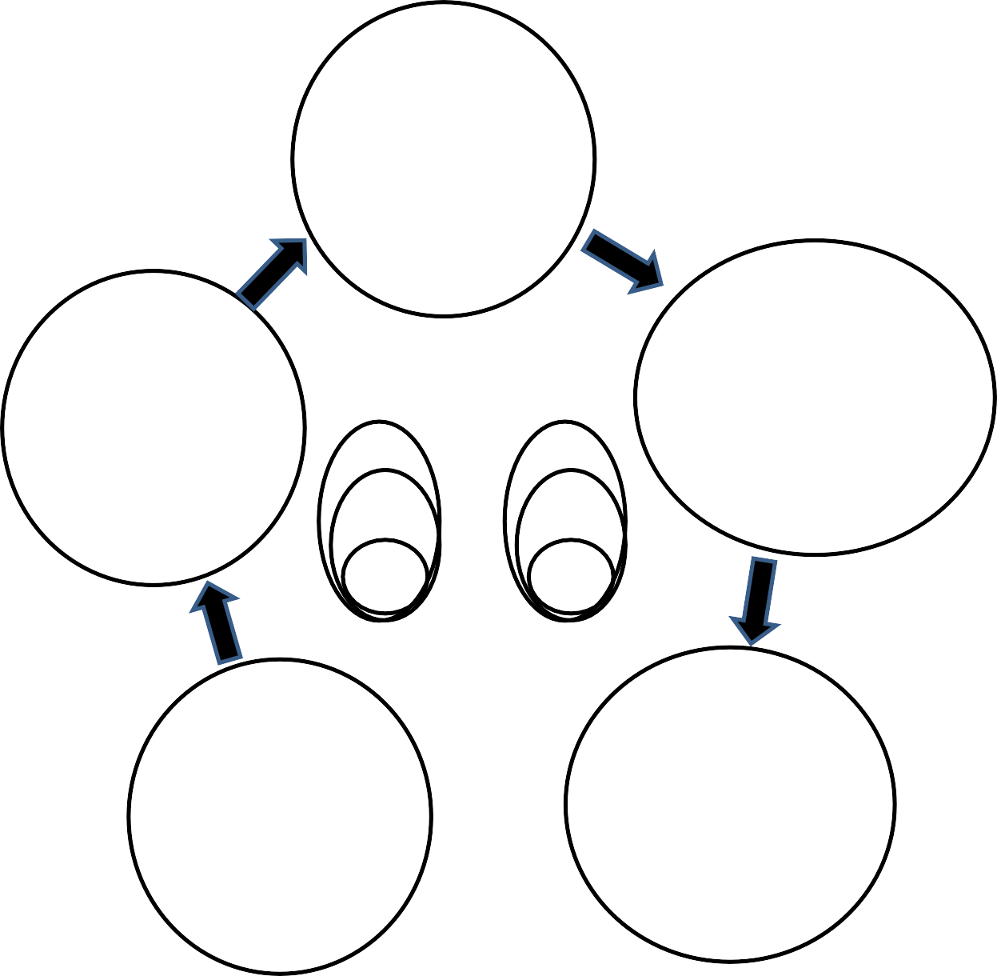
Business Model Design
Who demand
our firms additional
or different things ?
Creative and new Customer Segmentation
When and Where do you meet new or
additional customer?
New or additional way to meet customer
- New Channels
What
should be the countermeasures against the demand or expectation?
Catch new Value Proposition from upstream downstream supply chain
Technology
Market
Social
Market
knowledge
- New Customer
Relationships
Protectable knowledge
Potential
Market
patent
Market
How should firms recombine technologies and market ?
New or additional
Technological System
, motivated by users (customers, suppliers, partners, internals etc.
Why
should firms do reconfiguring process?
Cost and Revenue by revised or new processes and points

Slide 8
Business Model Design
Who(Customer Segmentation) (2 pages)
*Concretely define a customer
Main Considerations:
- Persona
- Noncustomer
- Adjacent market
- Overshooting

Slide 9
Business Model Design
2. What(Value propositions) (2 pages)
*Resolve a problem, provide a concrete value, meet a desire
Main Considerations:
Minimum viable product
- Feedback
- Pivot

Slide 10
Business Model Design
3. How(Technical System) (2 pages)
*Concrete system that creates value by combining technology and the market
Main Considerations:
Key resources
- Key activities
- Key partnerships

Slide 11
Business Model Design
4. Why(Revenue and cost) (2 pages)
*Cost structure and contents, profit structure and contents
Main Considerations:
Revenue Streams
- Cost Structure

Slide 12
Business Model Design
5. When and Where(Customer meeting) (2 pages)
*How to meet a customer, how to form customer relationships
Main Considerations:
Channels
- Customer relationships

